Slide 1
Customer Conversion Prediction

Slide 2
Problem Statement
There is an insurance company called New age insurance. The company has multiple outreach plans to sell term insurance to its customers. Telephonic marketing campaigns still remain one of the most effective way to reach out to people however they incur a lot of cost. Hence, it is important to identify the customers those are most likely to convert beforehand so that they can be specifically targeted via call.
The historical marketing data of the insurance company is provided. The aim is to build an ML model that will predict if a client will subscribe to the insurance.

Slide 3
Target Variable
Features
Age
Job
Marital Status
Education Qualification
Call Type
Day
Month
Duration
No. of calls
Previous
Outcome
Yes/No
age
type of job
marital status
education status
contact commu-nication type
last contact day of the month
last contact month of the year
last contact duration in seconds
number of contacts made during the campaign
outcome of the previous marketing campaign
whether the client subscribed to the insurance?

Slide 4
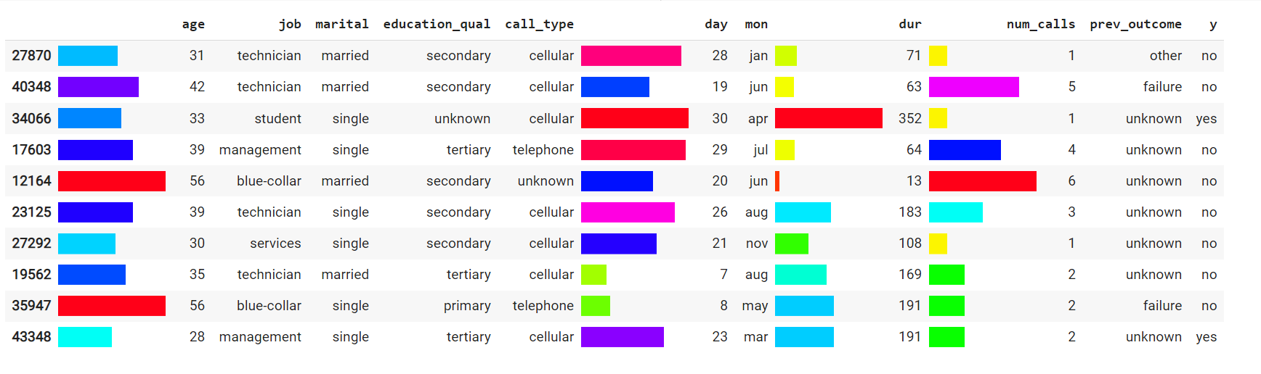

Glimpse of the data
Shape of the data = (45211 x 11)

Slide 5
Data is imbalanced

Slide 6
Insights from EDA
EDA: Exploratory Data Analysis

Slide 7
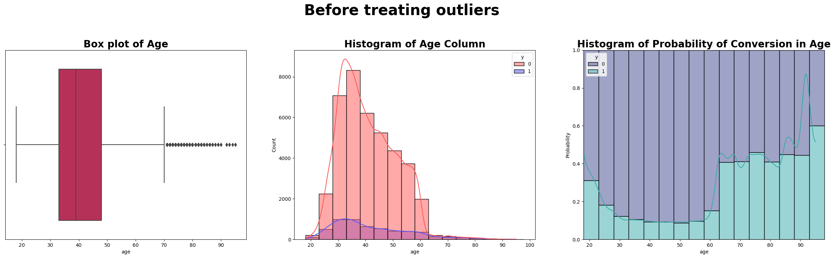
Age
The count of the age group 30 to 40 is high, the probability of conversion is very low(around 0.1).
The business firm contacted the age group 20 and 25 in less number, for this age group the probability of conversion lies in between 0.2 to 0.3 .
The business firm has good scope in this age group to convert them to take a policy.

Slide 8
Job
Unknown
Student
Blue-collar
Technician
Services
Self employed
Unemployed
Management
Admin
Retired
Entrepreneur
House maid

Slide 9
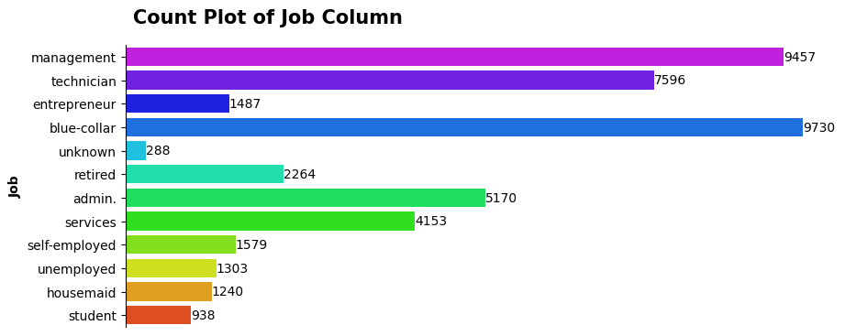
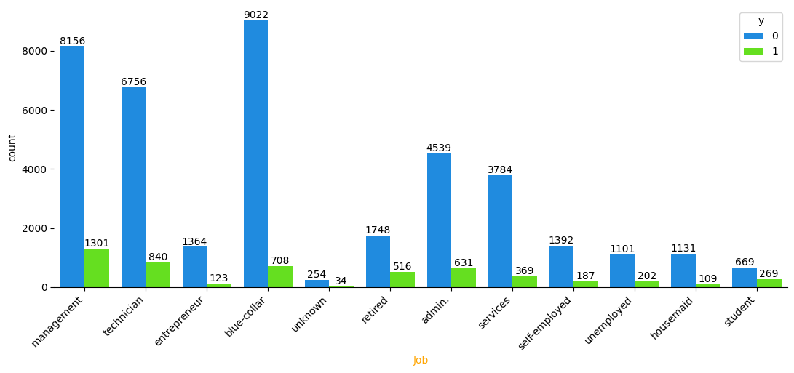

Slide 10
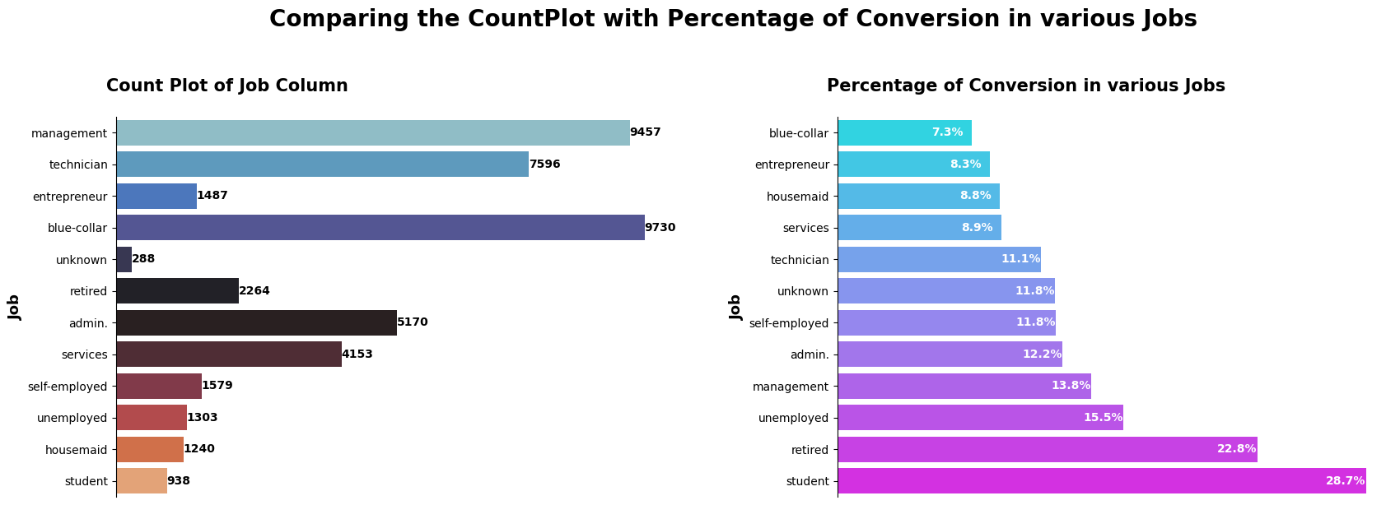
From the above plots, it is evident that students and retired people have more conversion rate.
But the business firm has contacted blue-collared people more where the conversion rate is the poorest among the all categories (This may be the reason that they are less educated).
Hence it is recommended to reach students, retired, unemployed and management people having conversion rates 29%,23%,16% and 14% respectively, rather than reaching blue-collared people.

Slide 11







Yes: 1912
Count: 12788
No: 10876
Single
Marital Status
Married
Yes: 2755
Count: 27210
No:24455
Divorced
Yes: 622
Count: 5207
No:4585

Slide 13
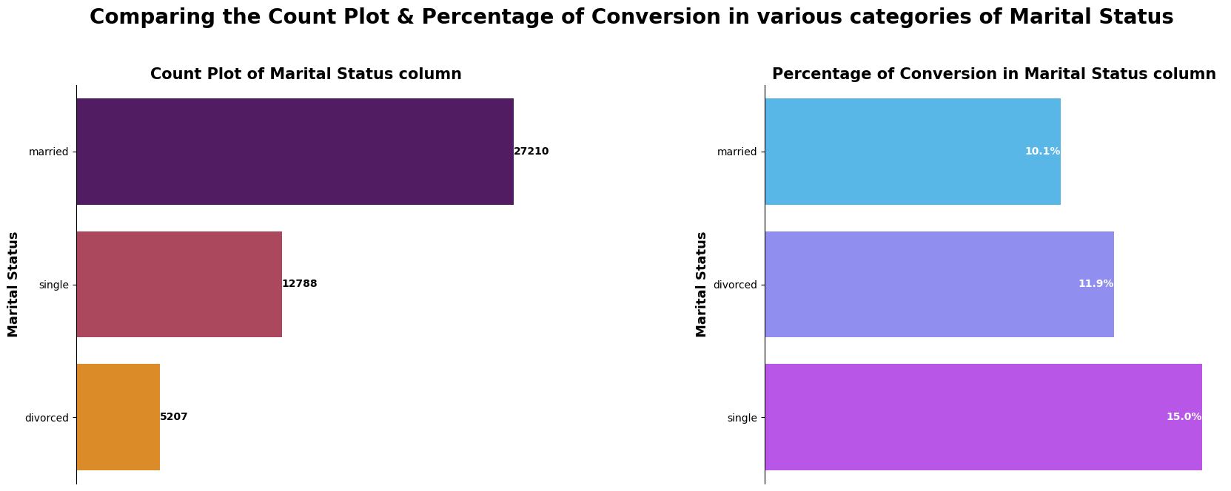
Singles have highest rate of conversion 15%.
The company has reached married people the most but they have least rate of conversion.
Hence, it is recommended to reach students more rather than married.

Slide 14
Unknown
Primary
Education Qualification
Tertiary
Secondary

Slide 15
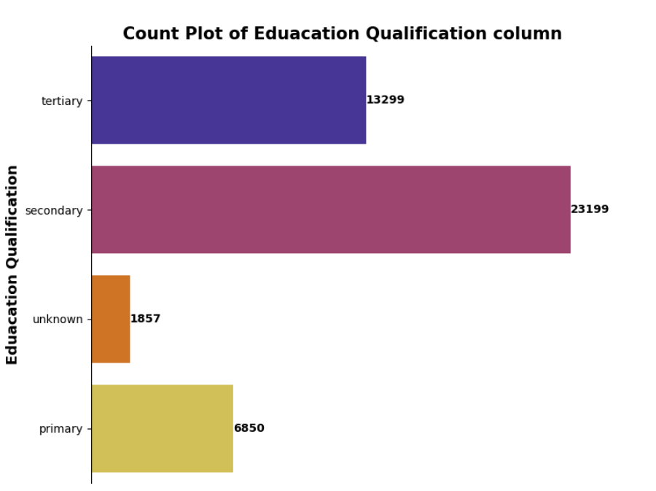
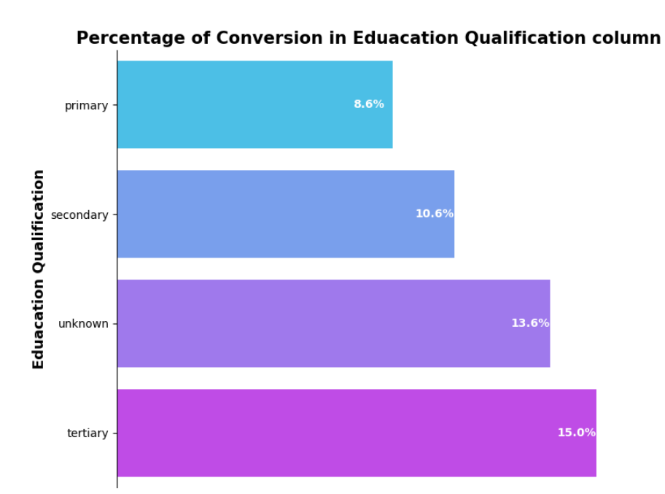
Tertiary category has the highest rate of conversion 15%, secondary category have 10.56% and the lowest is 8.62% for primary.
Therefore contacting the higher educated people will result in more success in converting them to subscribe to a policy.

Slide 16




Call Type
Telephone
Cellular
Unknown
Count: 2906
Count: 29282
Count: 13017
Yes: 390
No: 2516
Yes: 4369
No: 24913
Yes: 530
No: 12487

Slide 17
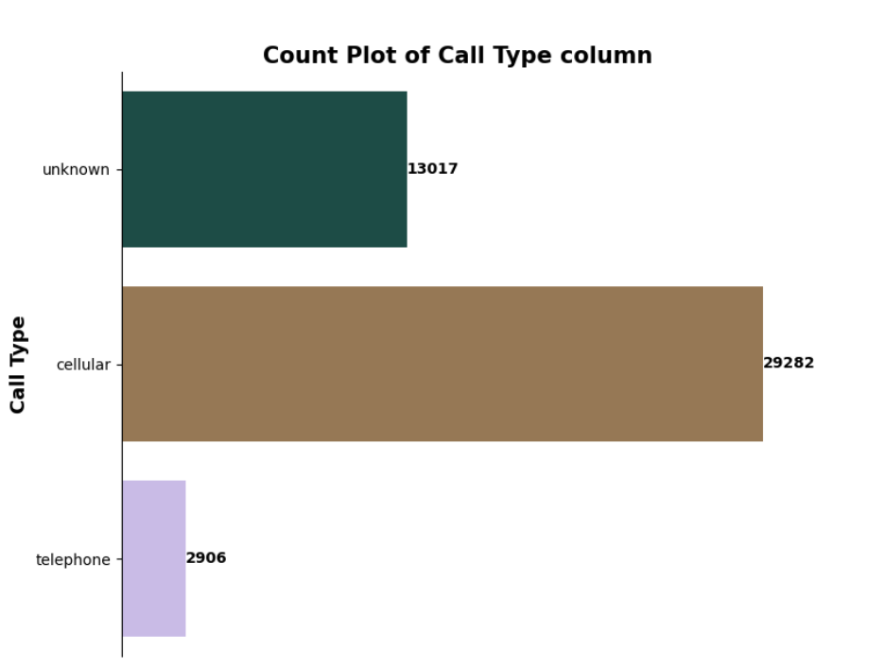
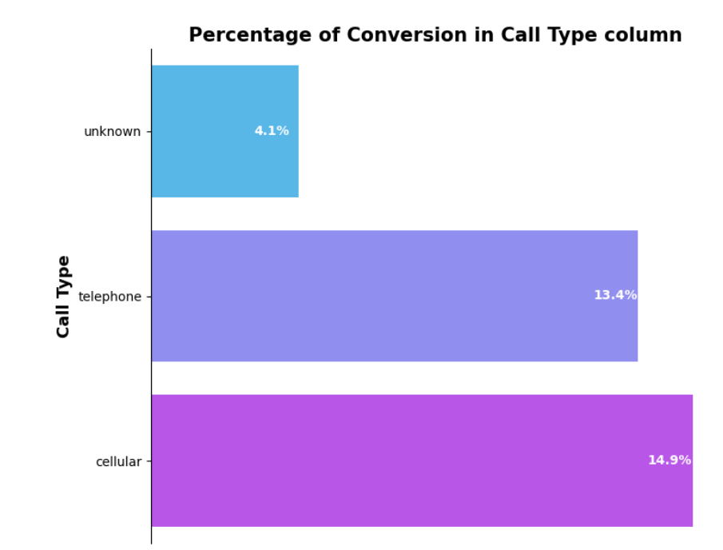

Cellular has the highest rate of conversion 14.9%. Also the firm contacting more to Cellular type

Slide 18
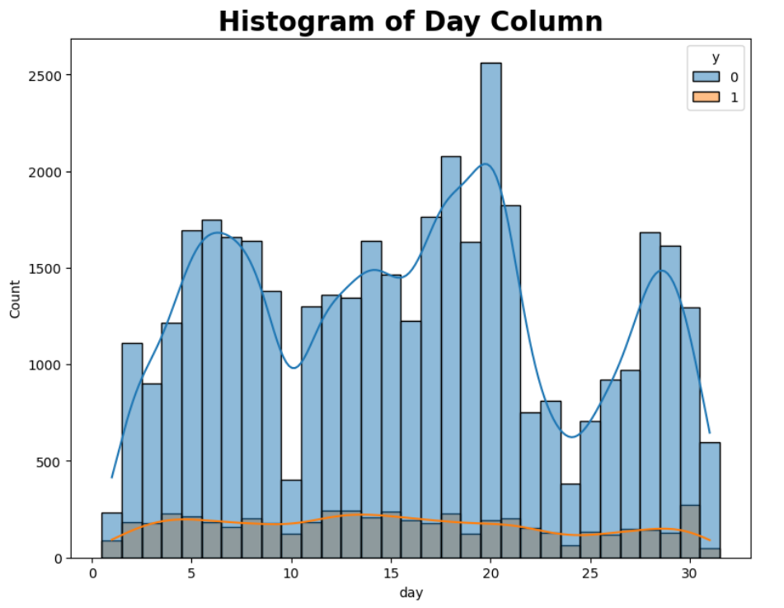

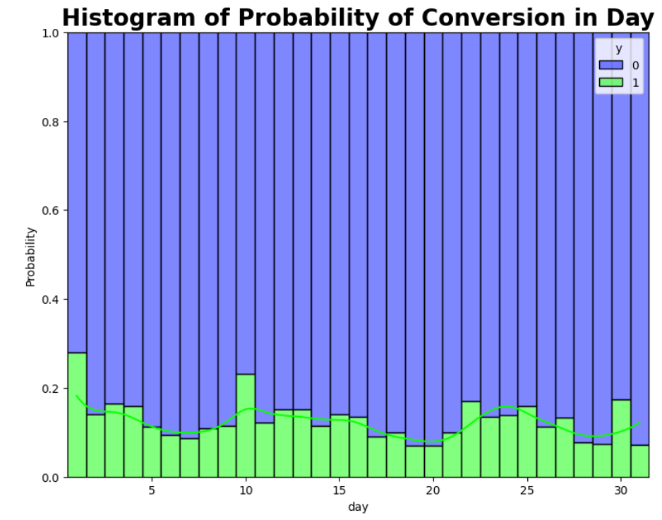
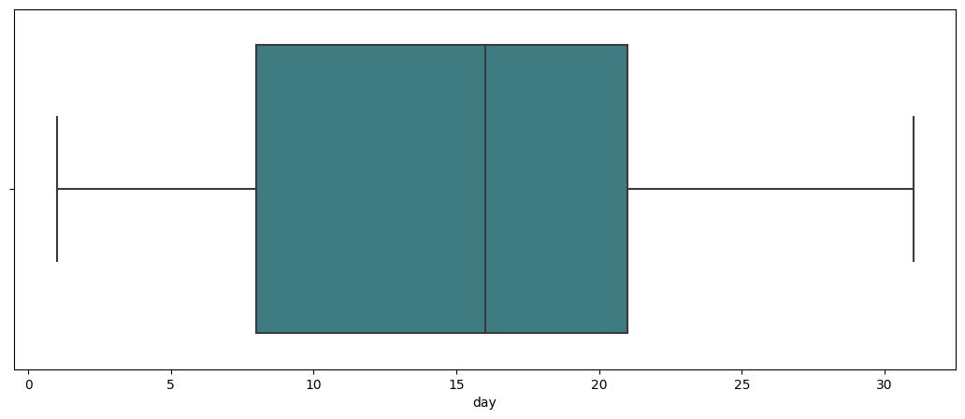
Day
Last contact day of the month

Slide 19

Month
Yes: 441
No: 2208
Yes: 577
No: 2355
Yes: 546
No: 4793
Yes: 142
No: 1261
Yes: 248
No: 229
Yes: 925
No: 12840
Jan (1403)
Feb (2649)
Mar (477)
April (2932)
May (13765)
June (5339)
July (6894)
Aug (6245)
Sep (579)
October (738)
Nov (3970)
December (214)
Yes: 627
No: 6267
Yes: 269
No: 310
Yes: 403
No: 3567
(#) represents the count
Yes: 688
No: 5557
Yes: 323
No: 415
Yes: 100
No: 114

Slide 20
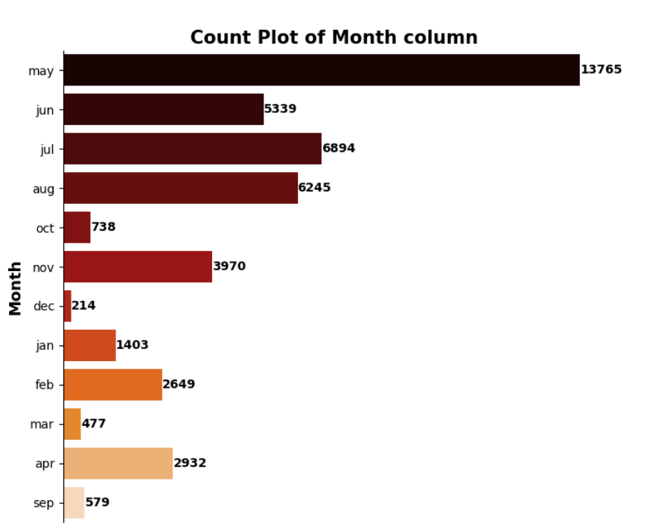
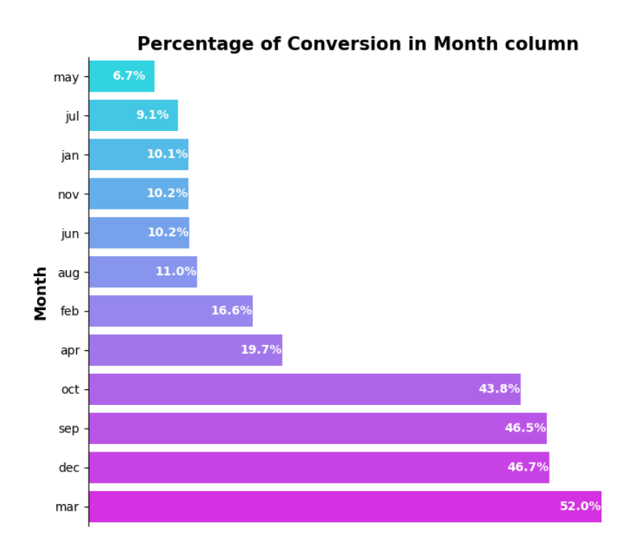
March has highest rate of conversion 51.99%, this is in line with our general knowledge that in India the financial year closes in March, so many employees purchase policies for tax benefit.
Rather than approaching the customers in the month of May(only 6.71% of conversion rate) it is recommended to approach them in March, followed by December(46.7%),September(46.4%) and October(43.7%).

Slide 21

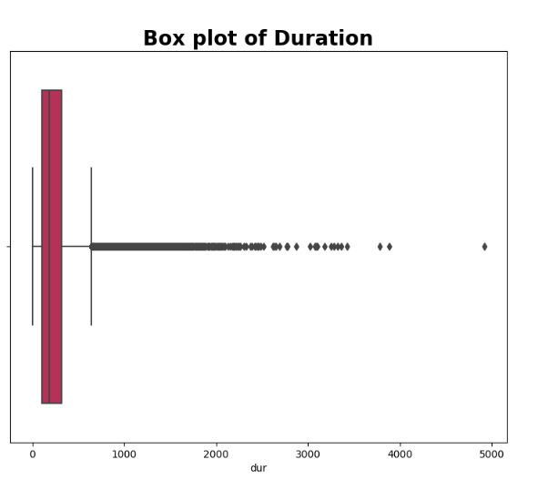
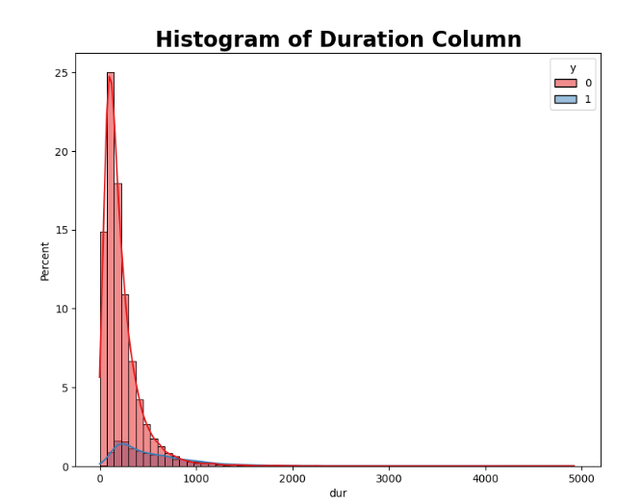
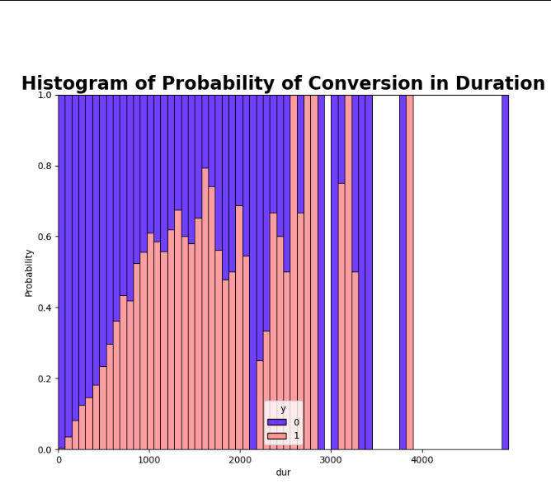
Duration
Last contact duration, in seconds

Slide 22
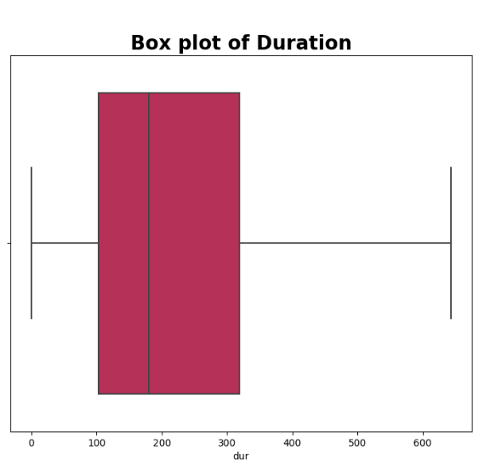
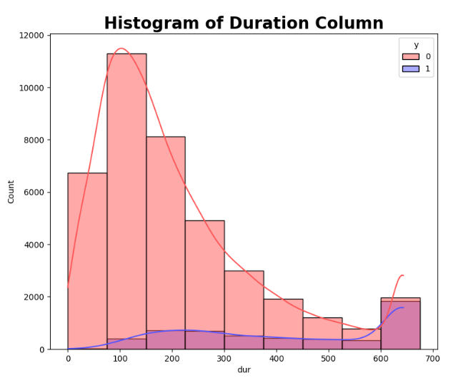
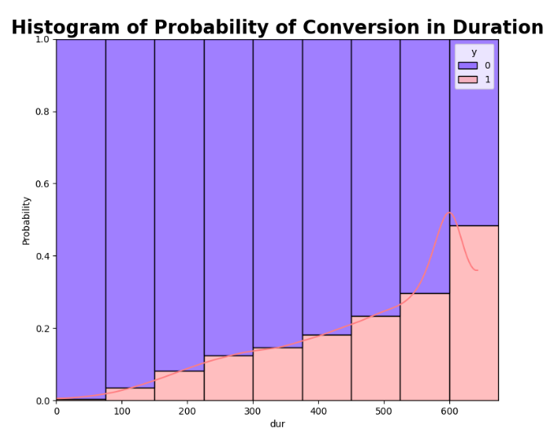
After treating the outliers
Upper threshold = 643 seconds Lower threshold = -221 seconds
From the above plots it is evident that as the duration increases the probability of conversion is increasing.

Slide 23

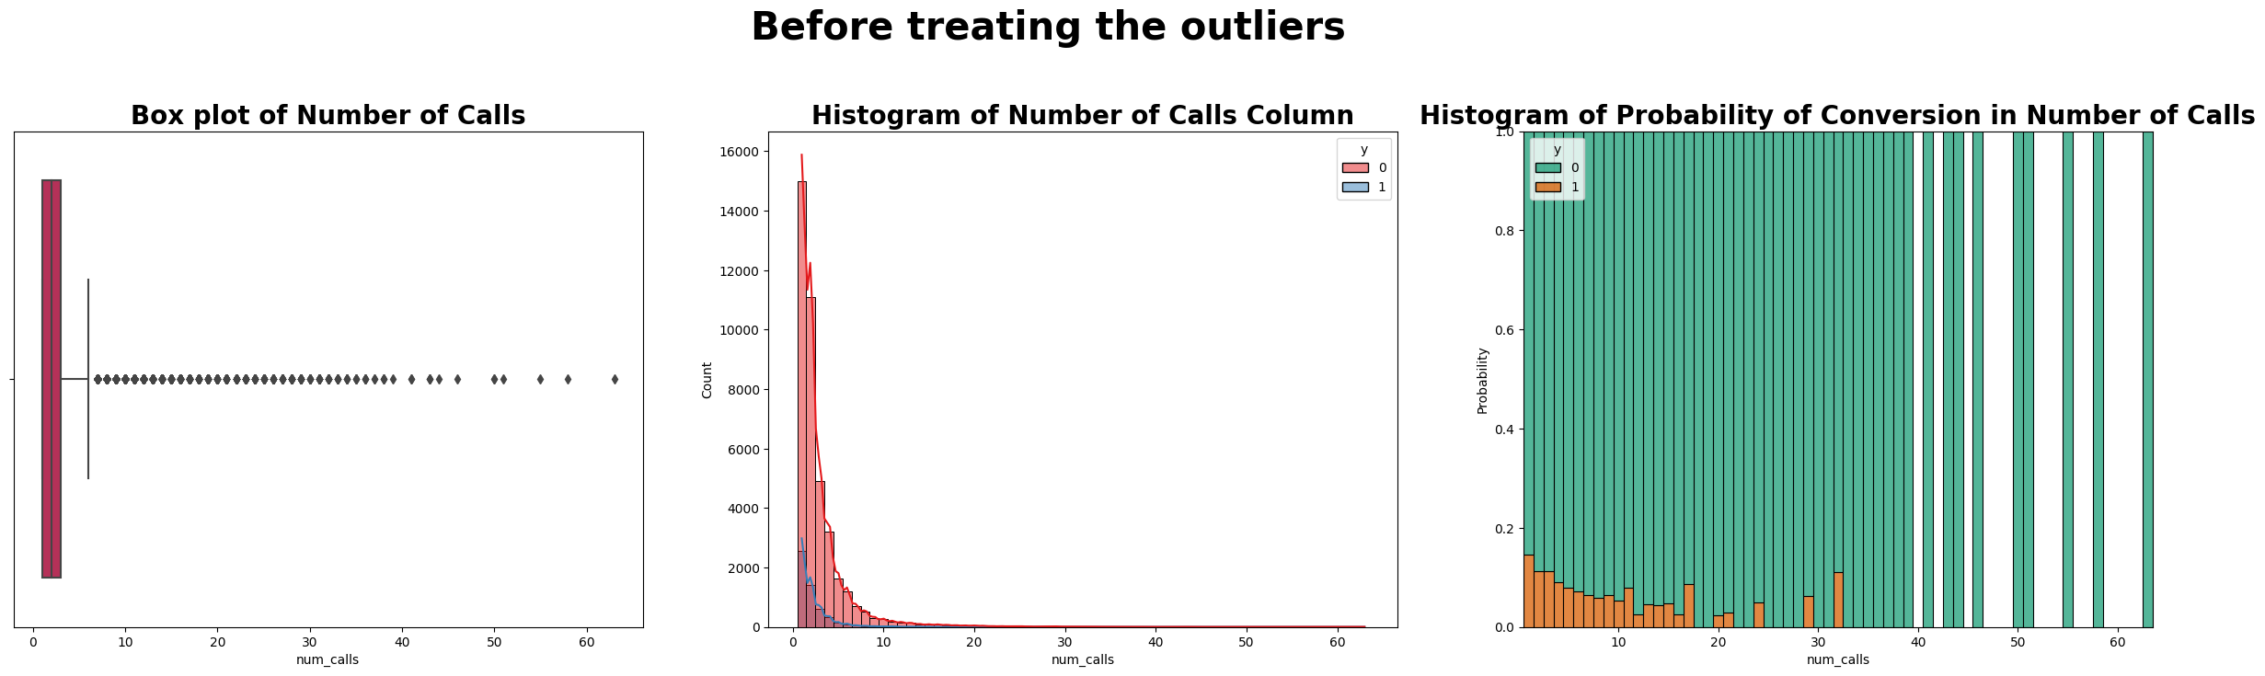
No. of Calls
number of contacts performed during this campaign and for a particular client

Slide 24
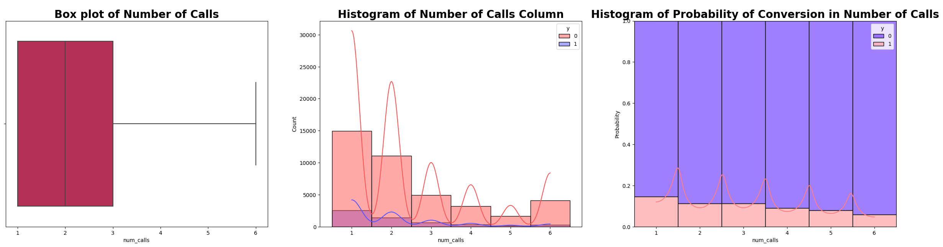
After treating the outliers
As the number of calls are increasing the probability of conversion is decreasing!!

Slide 25
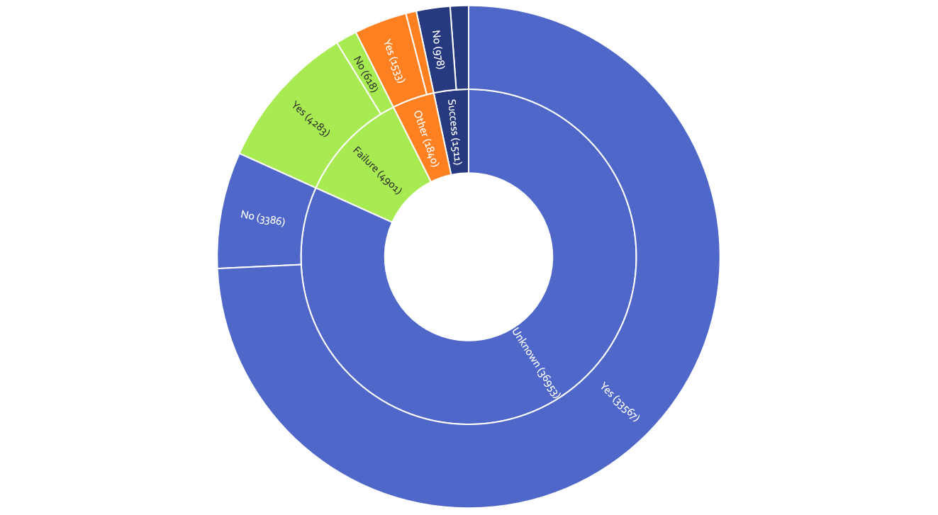
Previous
Outcome

Slide 26
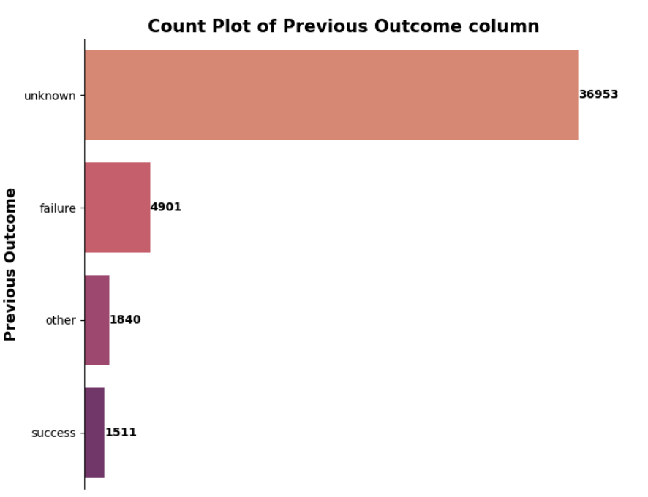
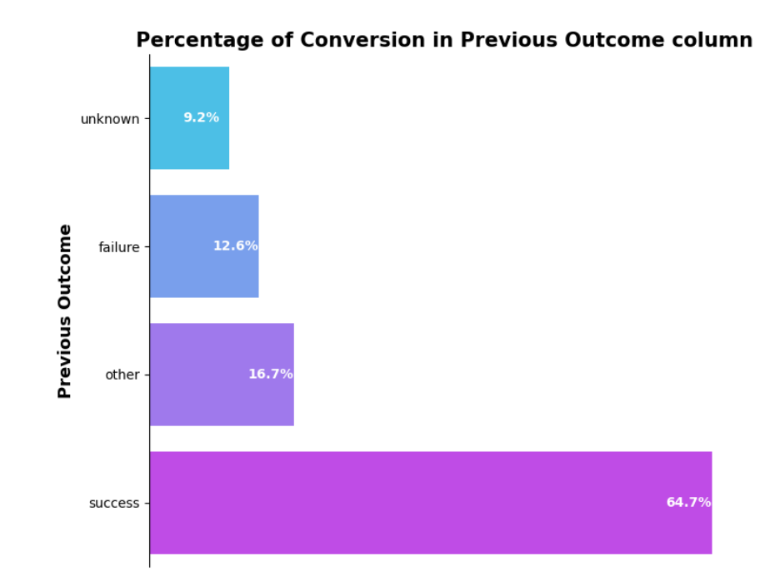
If the previous outcome of the call is 'success' the conversion rate of that call is 64.7%! Of course the word itself means that only.
Also the firm has some scope here to do some research, why though the previous outcome of the call is success, some people aren't purchasing the policy.
Chasing such type of customers once again may result in full success of converting them to purchase a policy.

Slide 27

Machine Learning Models

Slide 28
Encoding: Label Encoding
0
1
2
3
Splitting: Stratified splitting with train:test=80:20
Balancing Method: SMOTEENN

Slide 29
Different ML models were trained and developed.
Logistic Regression
AUROC Score: 0.87
KNN
AUROC Score: 0.87
Decision Tree
AUROC Score: 0.86
Random Forest
AUROC Score: 0.91
XG Boost
AUROC Score: 0.91
For code: https://github.com/BhanuSrihridai/Insurance-Company-Customer-Conversion-Prediction.git

Slide 30
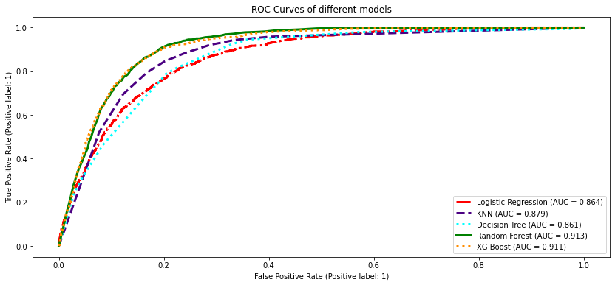

Slide 31
Thank you

